Slide 1
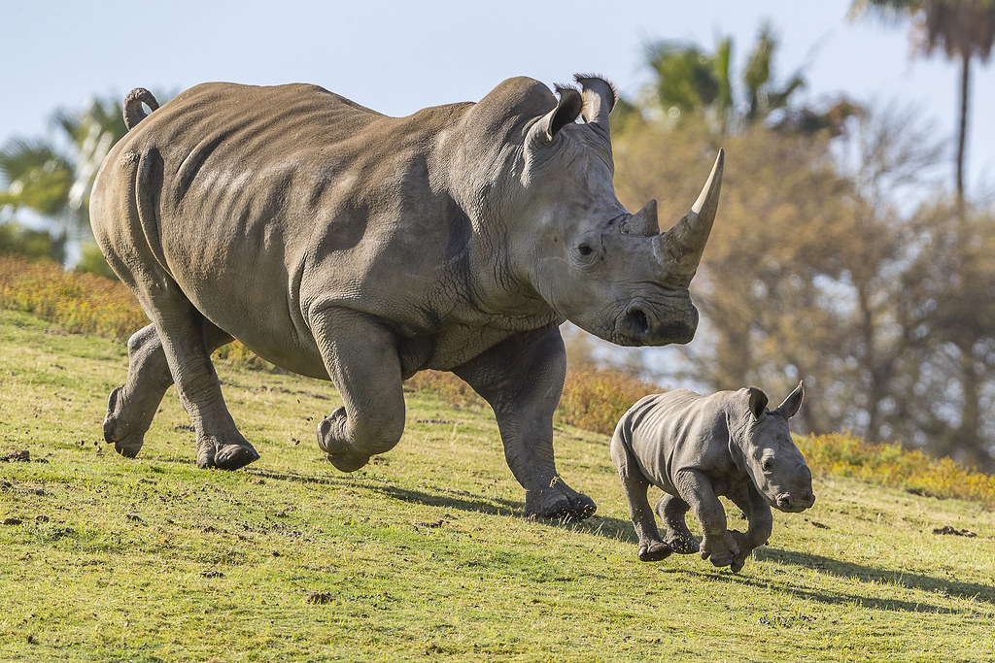
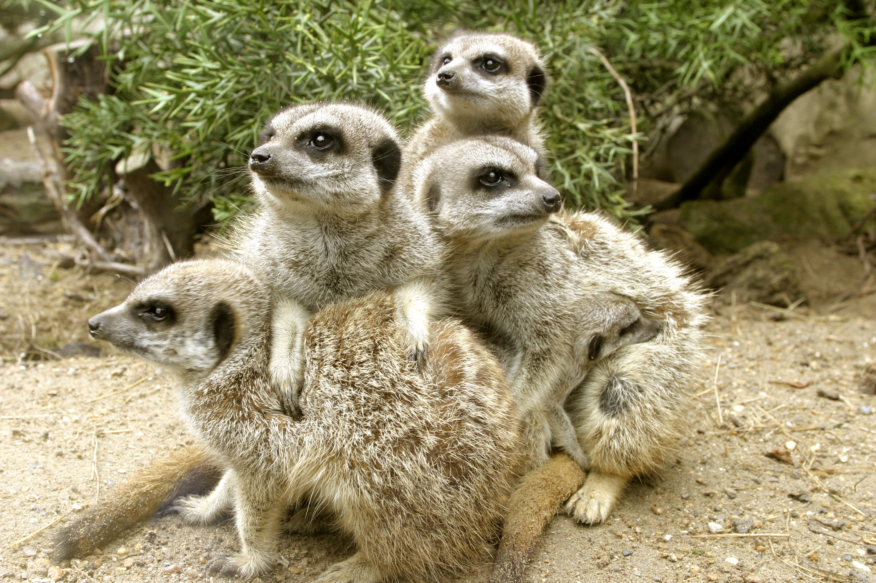
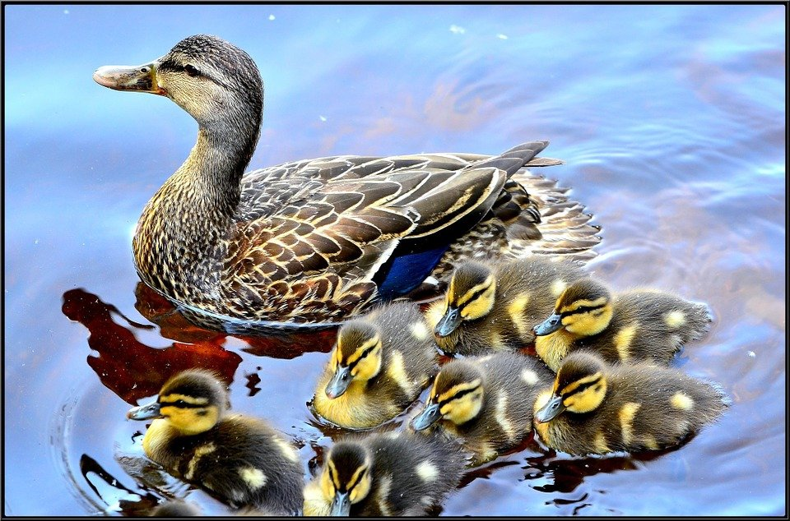
ANIMAL REPRODUCTION AND DEVELOPMENT
This Photo by Unknown Author is licensed under CC BY
This Photo by Unknown Author is licensed under CC BY-SA
Chapter 18

Slide 2
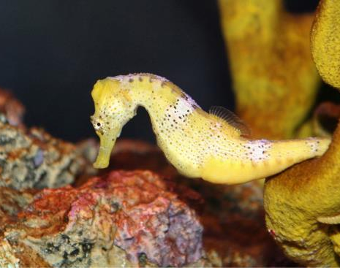
Animal Reproduction
Each species has its unique adaptations.
Seahorse and Pipefish reproduction is unlike any other animal.
Female seahorses produce eggs that are then fertilized by the male. Unlike with almost all other animals, the young then develop in a pouch of the male seahorse until birth. (credit: “cliff1066”/Flickr)
Seahorse reproduction

Slide 3
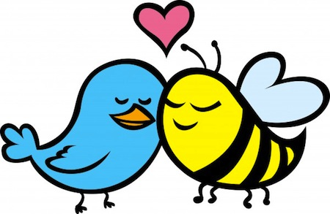
Types of Reproduction
Asexual Reproduction
fission
budding
fragmentation
parthenogenesis
Sexual Reproduction in Invertebrates
external fertilization
internal fertilization
Sexual Reproduction in Vertebrates
external fertilization
internal fertilization

Slide 4
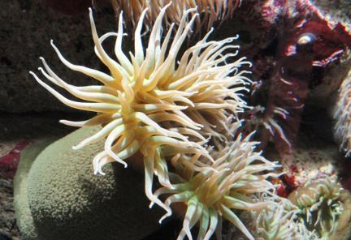
Asexual Reproduction
Fission:
Protists and some animals may reproduce by fission.
Division of one cell, body or body part into two.
The plane of division can be asymmetrical, transverse or longitudinal.
Very common in protozoa.
The Anthopleura artemisia sea anemone can reproduce through fission.

Slide 5
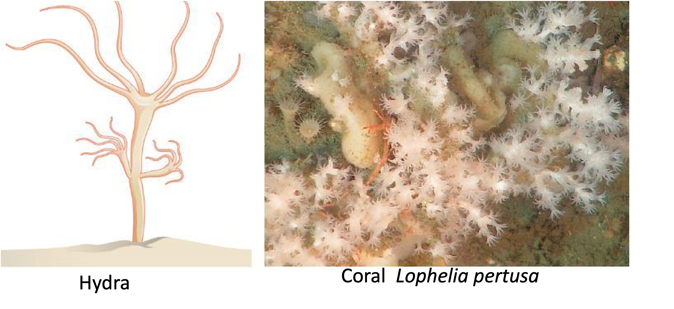
Asexual Reproduction
Budding:
This is a type of reproduction found in lower invertebrates.
Certain cells divide rapidly and develop on the body surface, forming an external bud.
This bud develops and breaks away as a new animal or it can stay attached and form a colony.
(credit b: modification of work by Ed Bowlby, NOAA/Olympic Coast NMS; NOAA/OAR/Office of Ocean Exploration)

Slide 6
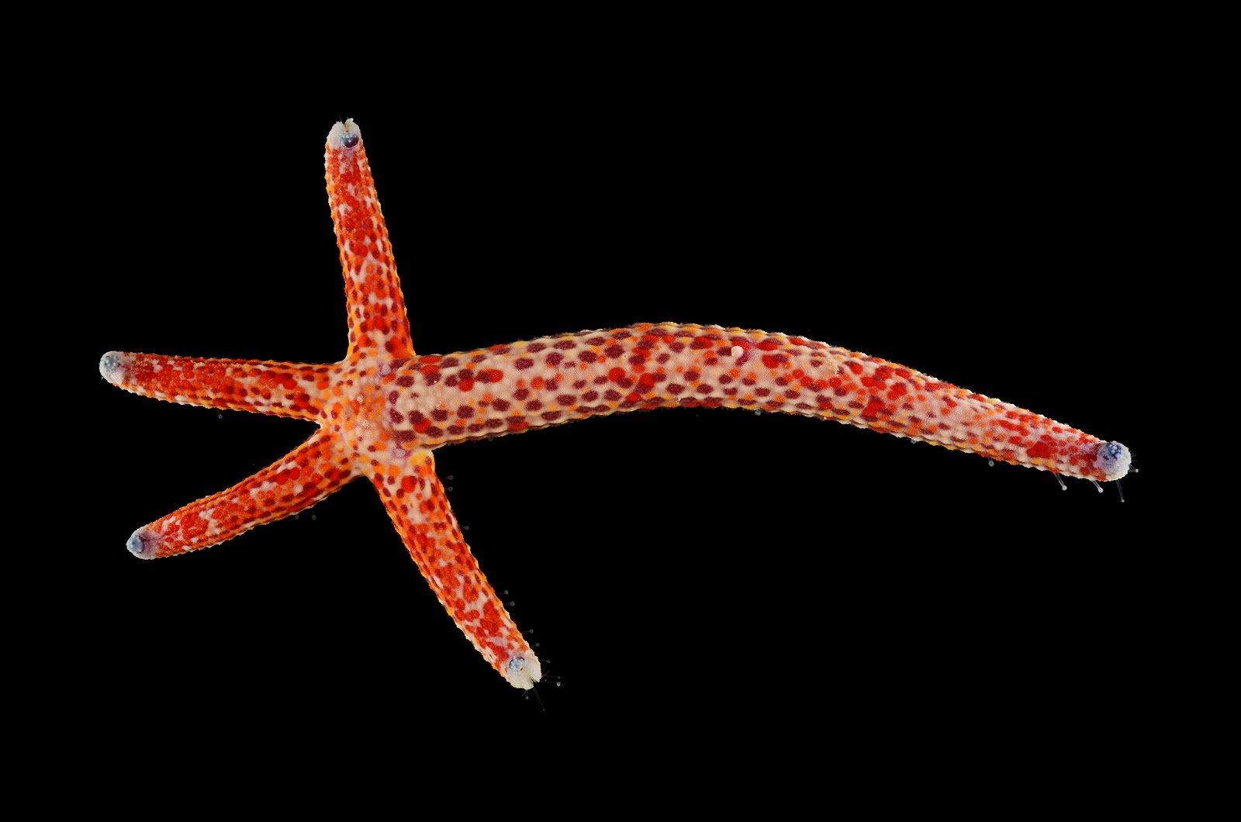
Asexual Reproduction
Fragmentation:
A body part is lost and then regenerates into a new organism.
A good example is in the sea star.
This Photo by Unknown Author is licensed under CC BY

Slide 7
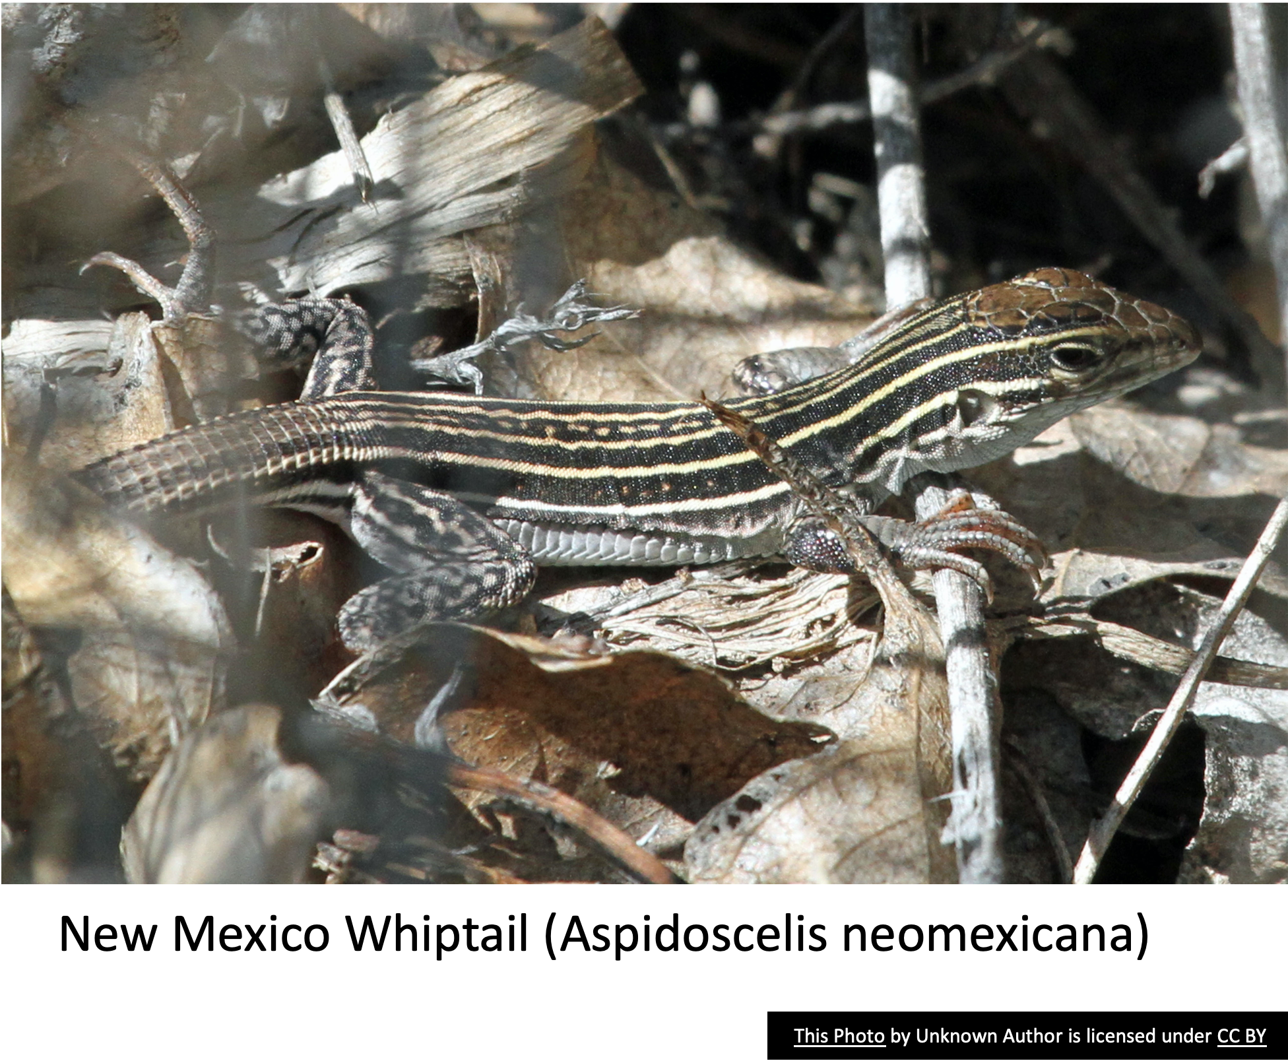
Asexual Reproduction
Parthenogenesis:
Spontaneous activation of a mature egg, followed by normal cell divisions and subsequent embryonic development.
Some flatworms, rotifers, roundworms, insects, lobsters, lizards and some fishes
In the news recently California Condors in captivity

Slide 8
Asexual Reproduction
Advantages:
isolated individuals can produce offspring & populate a new part of the species range
ok to have less variability in very stable environments
only need one parent to reproduce
generates more offspring faster than sexual reproduction
costs less in terms of metabolic energy than sexual reproduction
asexual reproduction always works

Slide 9
Asexual Reproduction
Disadvantages:
Genetic diversity remains fixed
Lack of genetic variability
Population can be wiped out by one diseases or environmental problem
Mutations - can be rare but lethal in all offspring

Slide 10
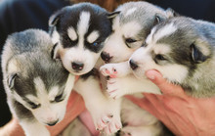
Sexual Reproduction
Combination of reproductive cells from two individuals to form genetically unique offspring.
Individuals that produce the two kinds of gametes can vary
for example, separate sexes or both sexes in each individual.
Sex determination
the mechanism that determines which sex an individual develops into, also can vary.

Slide 11
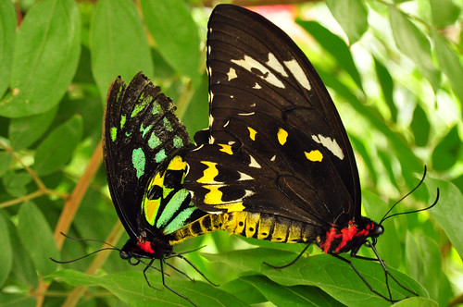
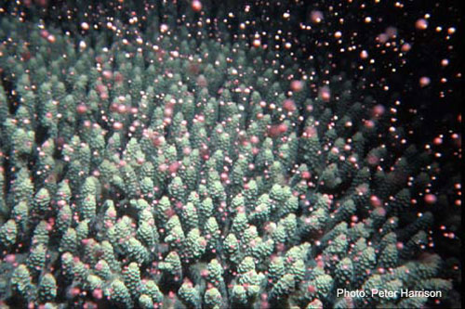
Sexual Reproduction in Invertebrates
Internal Fertilization: invertebrates that utilize internal fertilization to transfer sperm from male to female and have structures that facilitate the transfer.
hermaphroditism
sequential hermaphroditism
bisexual
External Fertilization: many invertebrates simply release their gametes into the water in which they live allowing fertilization to occur (spawning).
This Photo by Unknown Author is licensed under CC BY-SA-NC

Slide 12
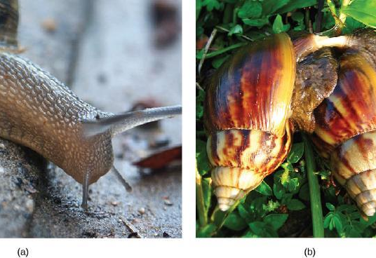
Sexual Reproduction
Hermaphroditism
Both male and female organs in the same individual (monoecious, hermaphrodites)
Most avoid self-fertilization
Exchange gametes with member of same species

Slide 13
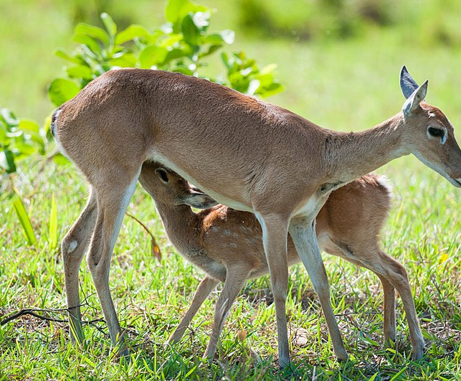
Sexual Reproduction - Sex Determination
Mammalian sex is determined genetically by the combination of X and Y chromosomes.
Individuals homozygous for X (XX) are female and heterozygous individuals (XY) are male.
This Photo by Unknown Author is licensed under CC BY-SA

Slide 14
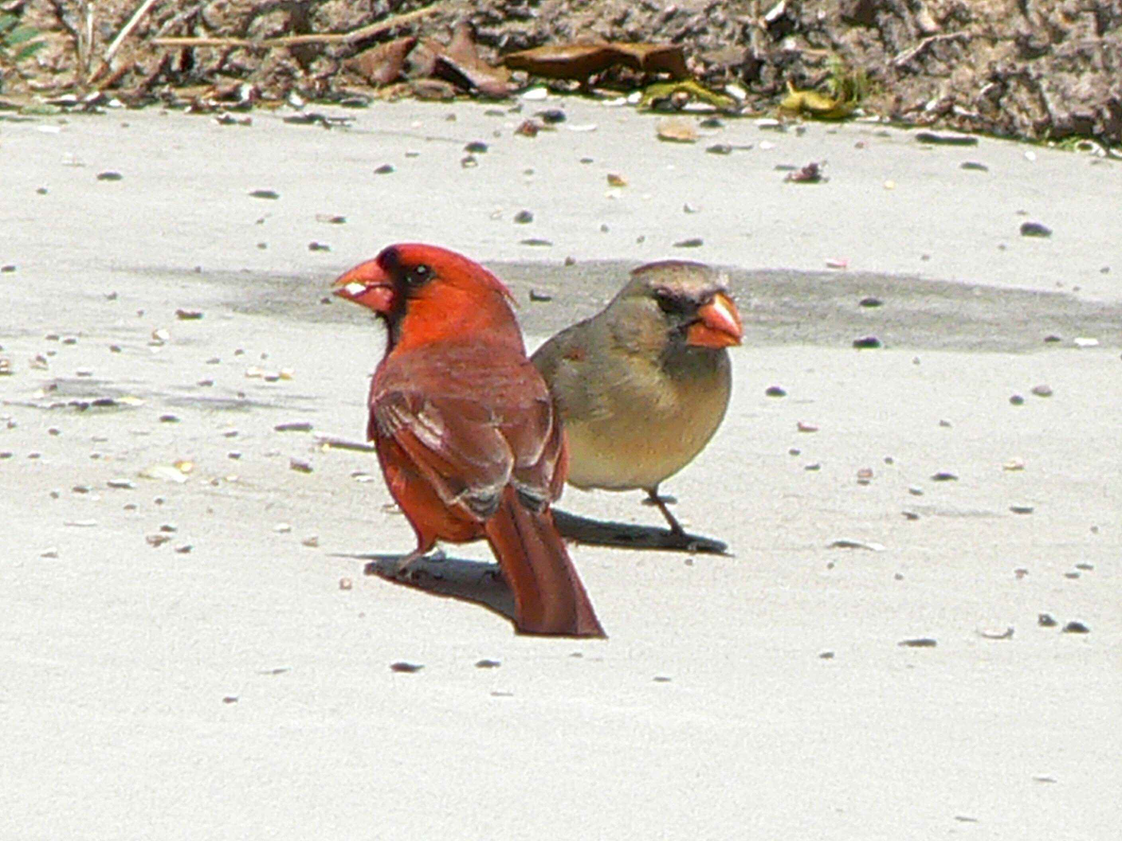
Sexual Reproduction - Sex Determination
Bird sex determination is dependent on the combination of Z and W chromosomes.
Homozygous for Z (ZZ) results in a male and heterozygous (ZW) results in a female.
Notice that this system is the opposite of the mammalian system because in birds the female is the sex with the different sex chromosomes.

Slide 15
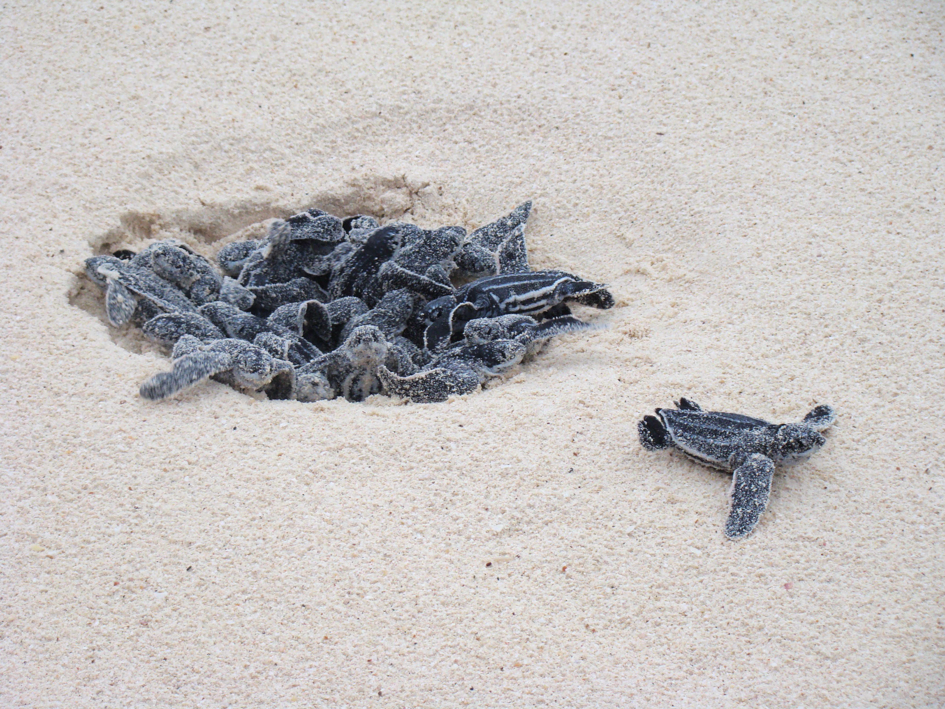
Sexual Reproduction - Sex Determination
Some other species
sex not determined by chromosomes, but by some aspect of the environment.
Sex determination in alligators, some turtles, and tuataras
dependent on the temperature during the middle third of egg development.
This Photo by Unknown Author is licensed under CC BY-SA

Slide 16
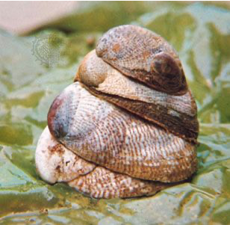
Sexual Reproduction - Sex Determination
Some species change their sex during their lives, such as the Slipper Limpets on right.
Oysters are born male, grow in size, and become female and lay eggs.
Wrasses, a family of reef fishes, are all sequential hermaphrodites.
Some of these species live in closely coordinated schools with a dominant male and a large number of smaller females.
If the male dies, a female increases in size, changes sex, and becomes the new dominant male.

Slide 17
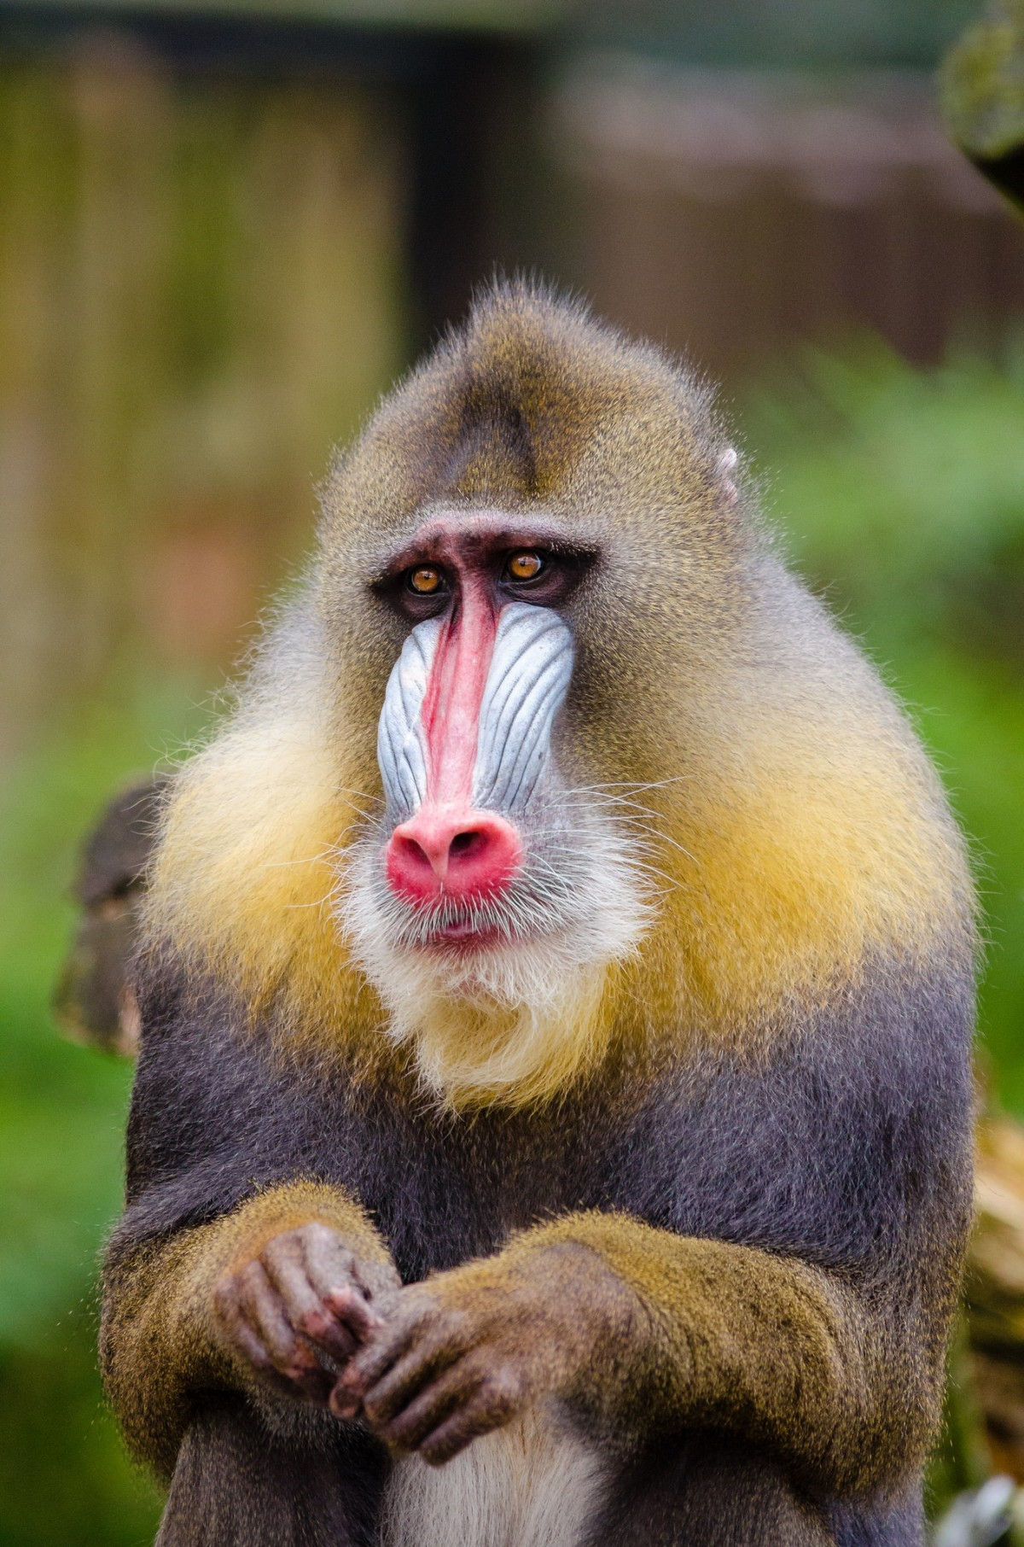
Sexual Reproduction - Bisexual Reproduction
Most common form
Produces offspring from union of gametes from two genetically different parents
Generally, individuals are male or female
Organisms are dioecious
Sexes are separate
Most vertebrates and many invertebrates

Slide 18
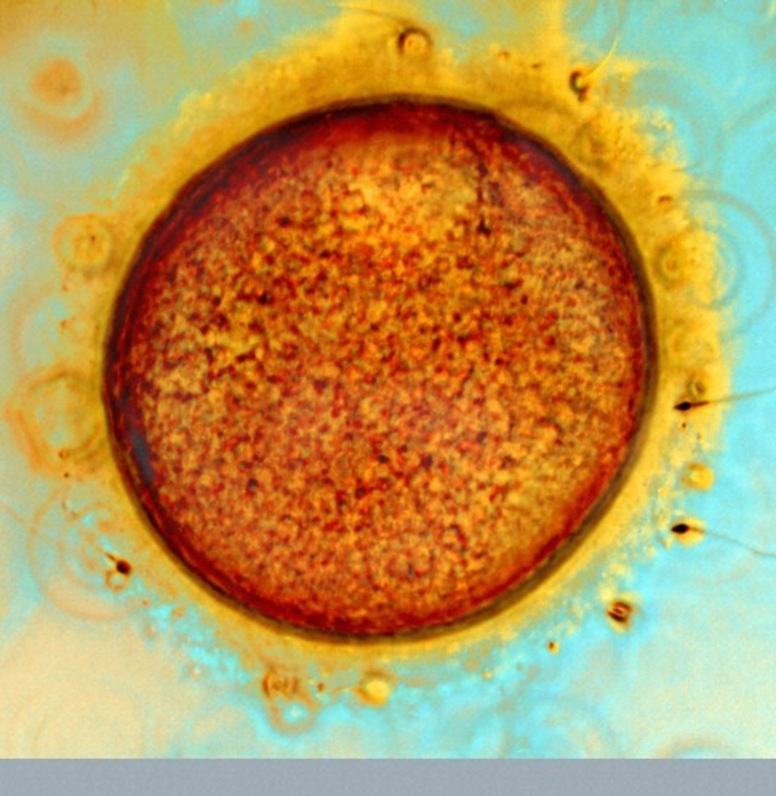
Sexual Reproduction - Bisexual Reproduction
Gonads
Organs that produce germ cells (gametes)
The female produces the ovum
Large with stored yolk and nonmotile
Spermatozoa are produced by the male
Small, motile and much more numerous
This Photo by Unknown Author is licensed under CC BY-ND

Slide 19
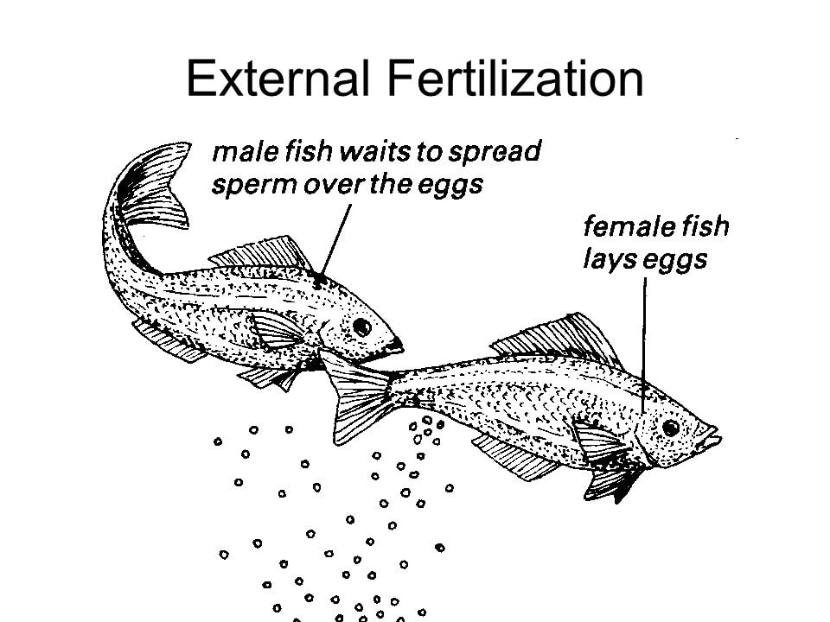
Reproductive Patterns - Fish
All fish reproduce in an aquatic environment.
Fertilization is usually external.
Thousands of eggs are produced and fertilized
few survive and grow to maturity.
This Photo by Unknown Author is licensed under CC BY-SA

Slide 20
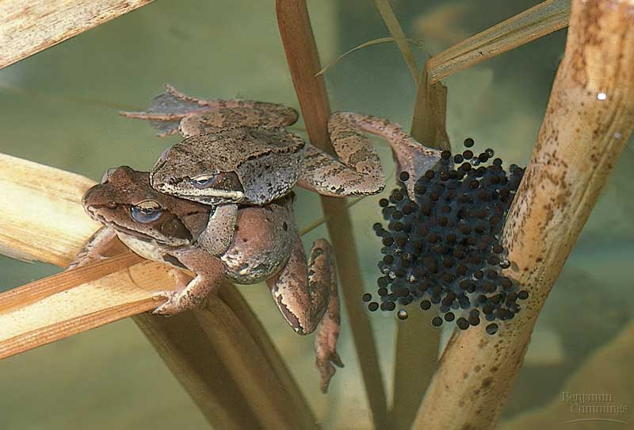
Reproductive Patterns - Amphibians
The amphibians were the first vertebrates to invade the land (although not completely).
Fertilization is usually external.
In frogs and toads, the male grasps the female and discharges fluid containing sperm onto the eggs as she releases them into the water.

Slide 21
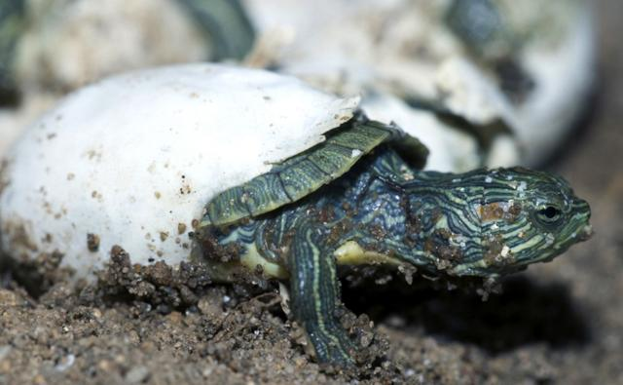
Reproductive Patterns- Oviparity
Lay eggs outside the body (“egg-birth”)
Fertilization may be internal (before eggs are laid) or external (after laid)
Some animals abandon eggs; others provide extensive care
Platypus, lizards, snakes, birds
This Photo by Unknown Author is licensed under CC BY-SA-NC

Slide 22
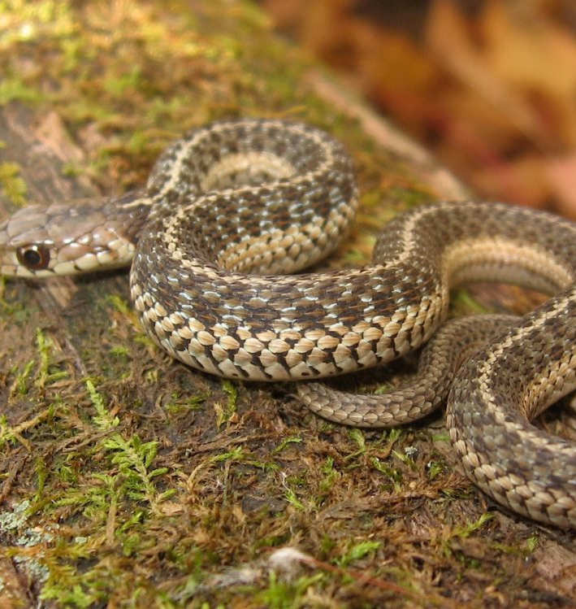
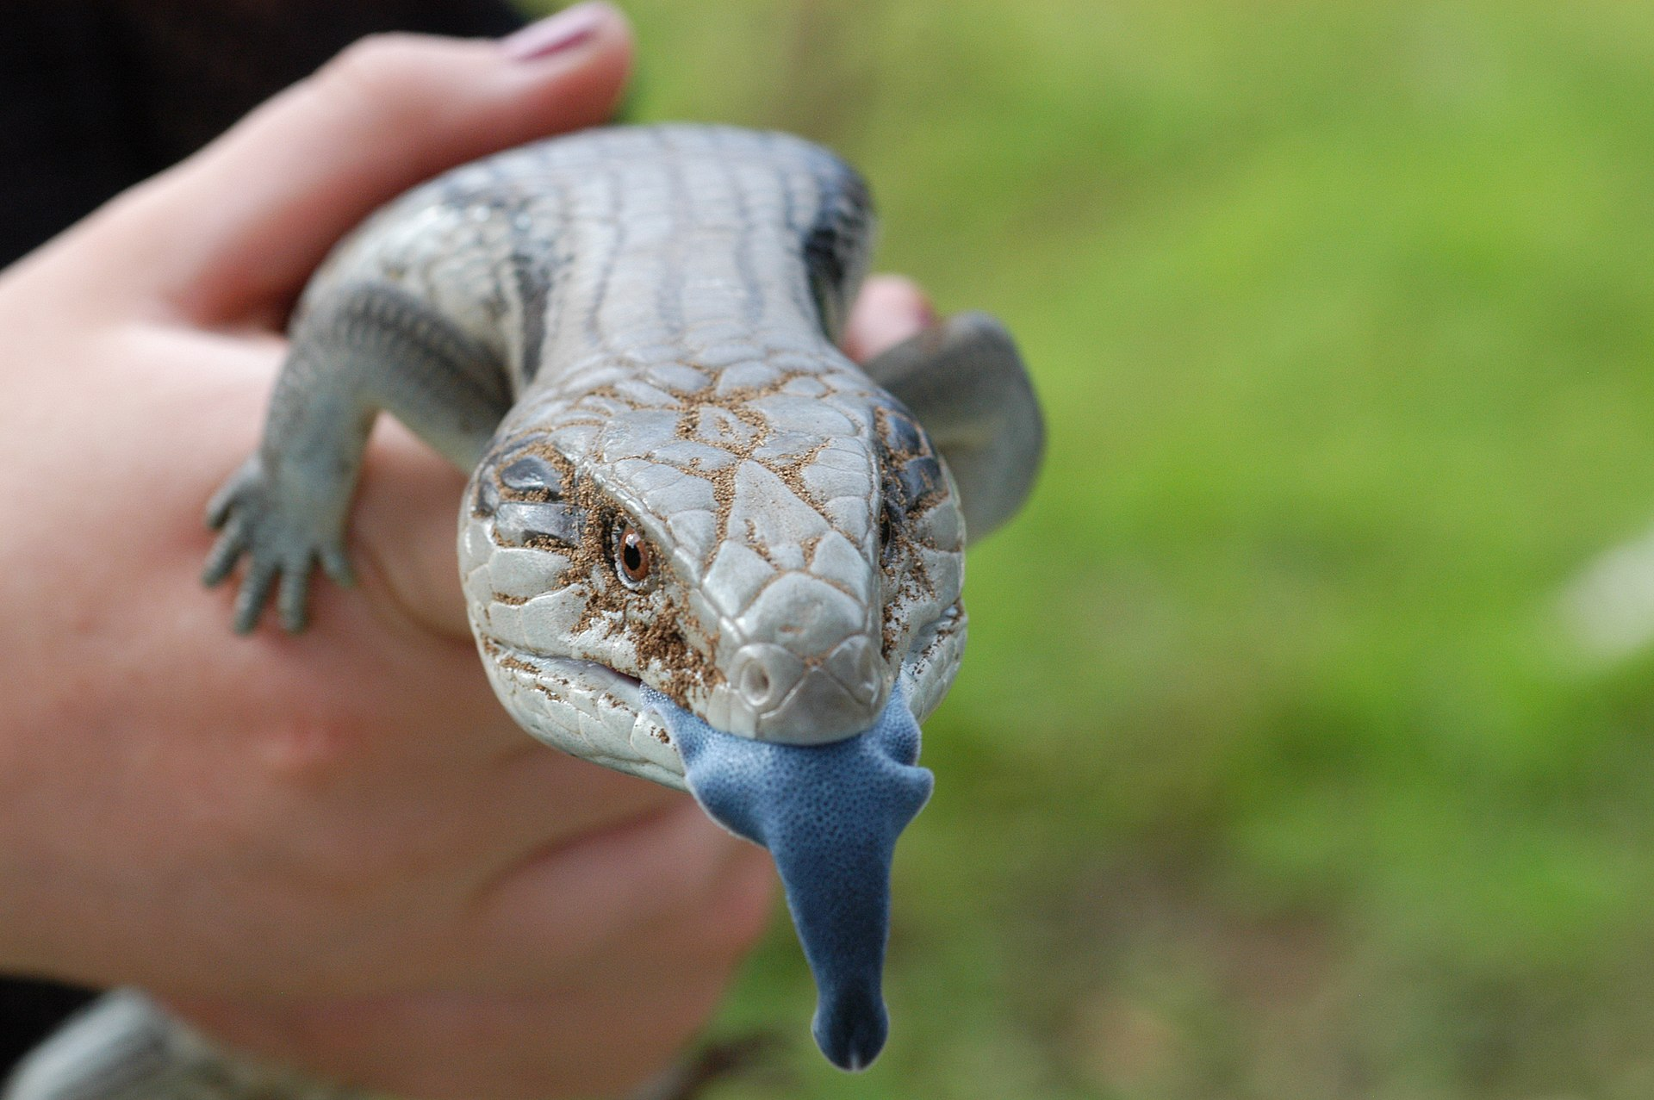
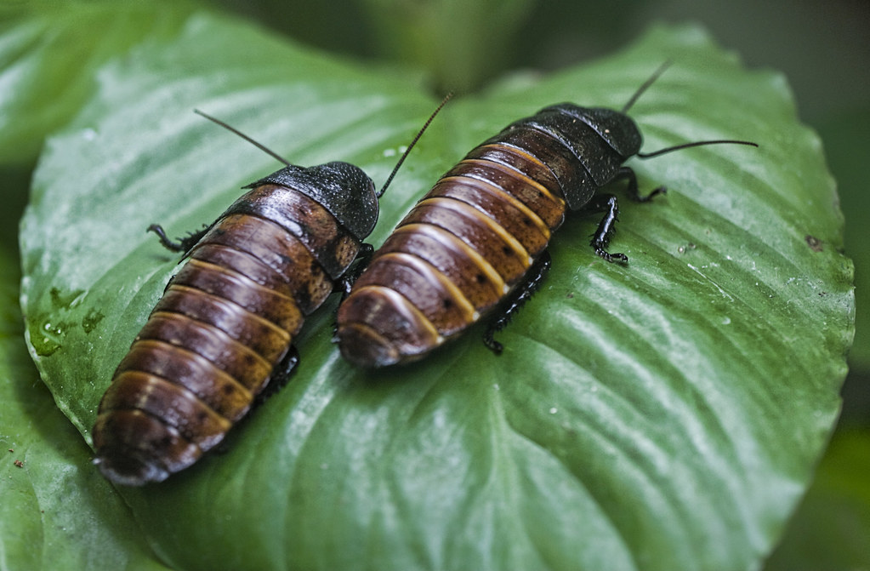
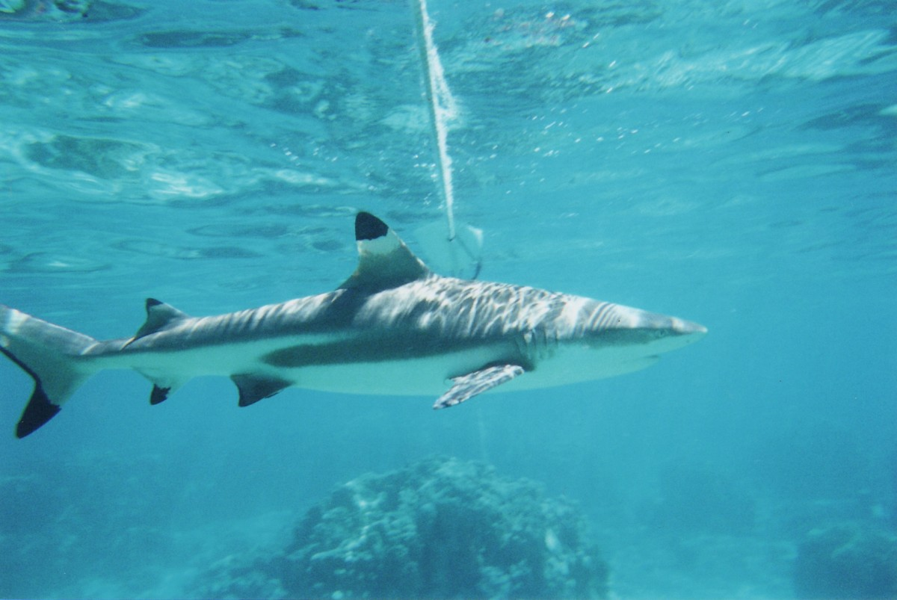
Reproductive Patterns- Ovoviparity
Fertilized eggs are retained in the female, and the embryo obtains its nourishment from the egg’s yolk.
The eggs are retained in the female’s body until they hatch inside of her, or she lays the eggs right before they hatch.
This process helps protect the eggs until hatching.
Some sharks, lizards, snakes; and Madagascar hissing cockroach
This Photo by Unknown Author is licensed under CC BY-SA
This Photo by Unknown Author is licensed under CC BY
This Photo by Unknown Author is licensed under CC BY-SA-NC

Slide 23
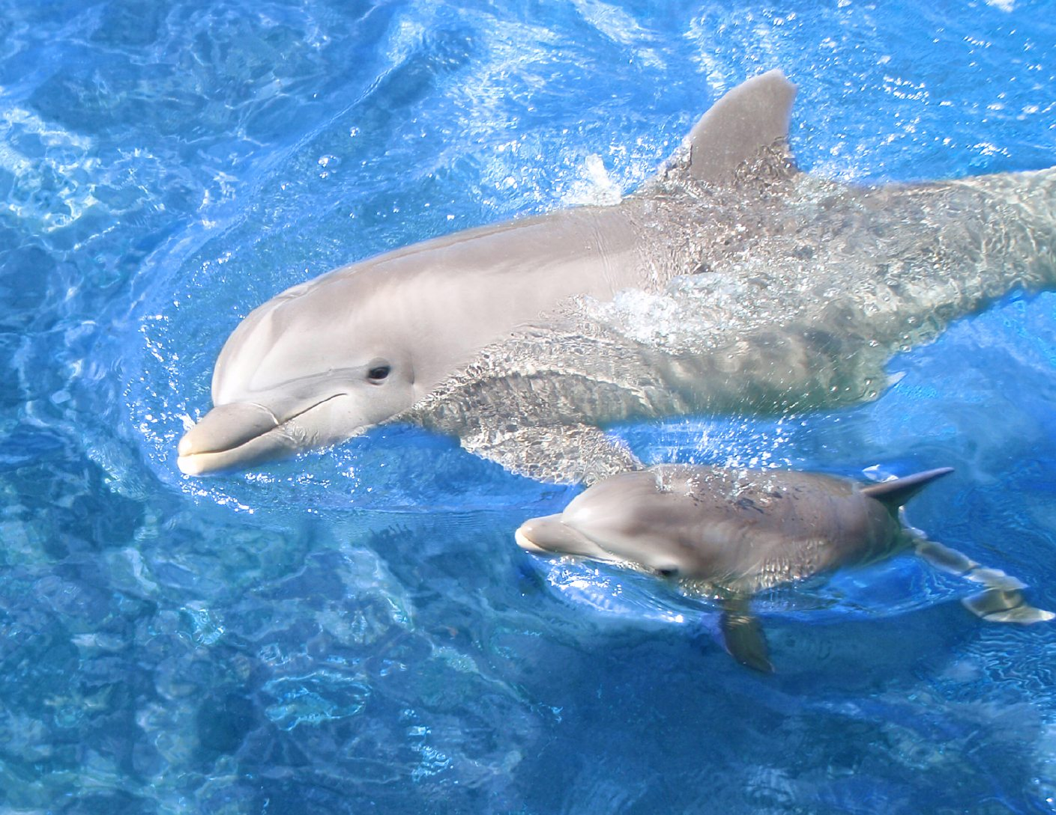
Reproductive Patterns- Viviparity
Live-birth Animals
Give birth to young in a more advanced stage of development
Eggs develop in oviduct or uterus
Embryos continuously derive nourishment from the mother
Fertilization is internal
Occurs in mammals and some fishes
Provides more protection to offspring
This Photo by Unknown Author is licensed under CC BY-SA-NC

Slide 24
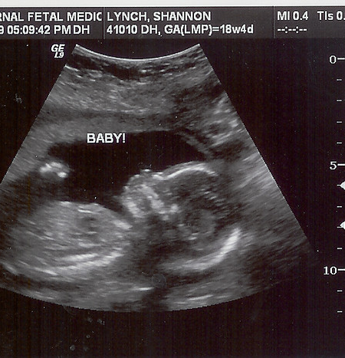
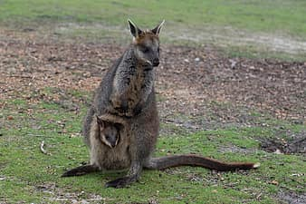
Reproductive Patterns – Mammals
With few exceptions, mammals have live birth.
Mammalian Live Birth:
marsupials: nourish young in a pouch after short gestation inside the female
continues to nourish the young after birth with milk from mammary glands
placentals: retain their young inside the female
mother nourishes the young by means of a placenta
continues to nourish the young after birth with milk from mammary glands
This Photo by Unknown Author is licensed under CC BY-NC-ND

Slide 25
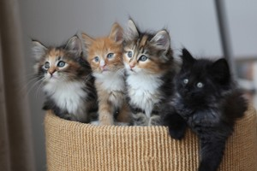
Sexual Reproduction
Advantages:
each offspring is a genetically unique animal (new combinations of traits, genes)
*this variability can increase chances for survival in the environment
variation is the foundation for evolution
populations of genetically varied individuals tend eliminate lethal/harmful mutations (those with mutation less likely to reproduce and the trait ends there)
This Photo by Unknown Author is licensed under CC BY

Slide 26
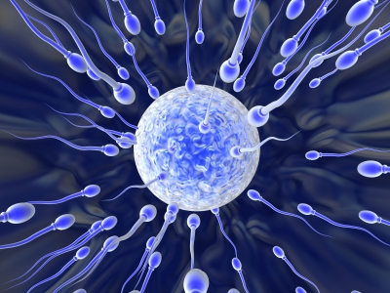
Sexual Reproduction
Disadvantages:
animal cannot reproduce on its own
animal cannot give its offspring a full copy of its own genes
many gametes released are not fertilized, so there is significant waste of metabolic energy/effort
This Photo by Unknown Author is licensed under CC BY-NC

Slide 27
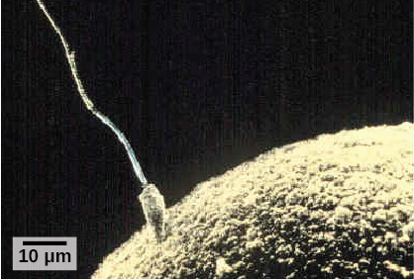
Development and Organogenesis
Fertilization is the process in which sperm and egg fuse to form a zygote. (credit: scalebar data from Matt Russell)
Human Fertilization

Slide 28
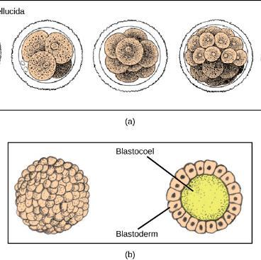
Early Development
(a) During cleavage, the zygote rapidly divides into multiple cells.
(b) The cells rearrange themselves to form a hollow ball called the blastula. (credit a: modification of work by Gray’s Anatomy; credit b: modification of work by Pearson Scott Foresman; donated to the Wikimedia Foundation)

Slide 29
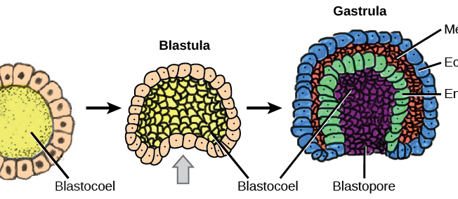
Early Development - Organogenesis
Gastrulation is the process wherein the cells in the blastula rearrange themselves to form the germ layers. (credit: modification of work by Abigail Pyne)
three germ layers:
the endoderm,
the ectoderm, and
the mesoderm.
Organs develop from the germ layers through the process of differentiation.

Slide 30
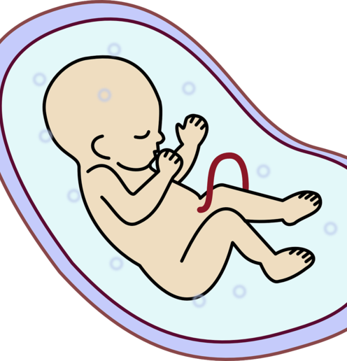
Human Reproduction
Adaptations for reproduction in humans are complex.
They involve specialized and different anatomies in the two sexes,
Occurs in early embryonic development
a hormone regulation system,
and specialized behaviors
regulated by the brain
and endocrine system.
This Photo by Unknown Author is licensed under CC BY-SA

Slide 31
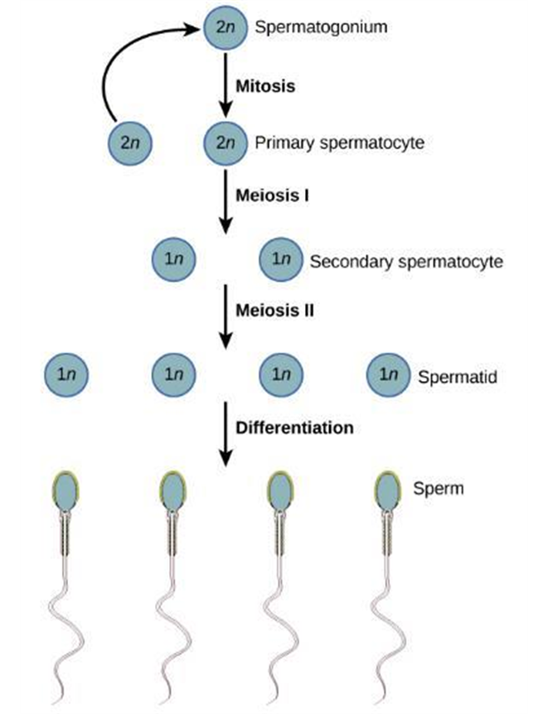
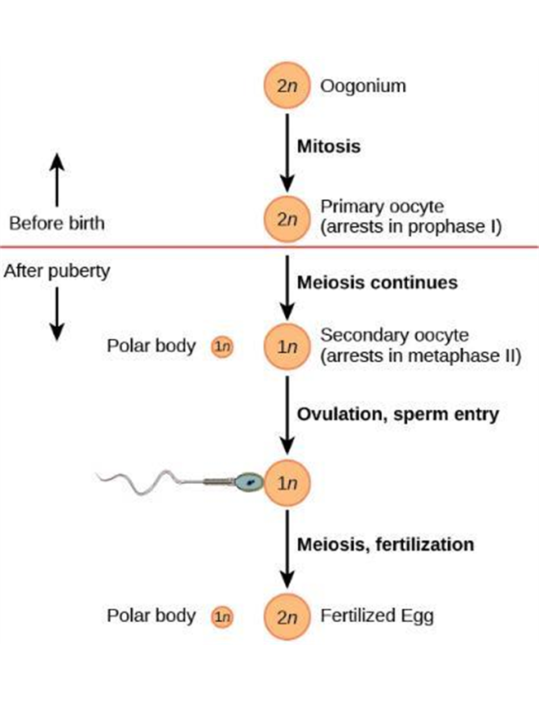
Gametogenesis
The formation of
Eggs by the female
Sperm by the male

Slide 32
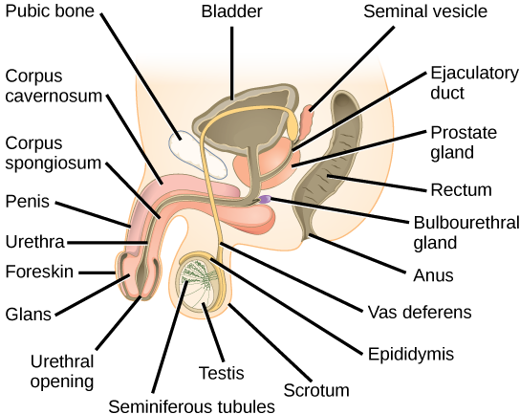
Male Reproductive Anatomy
Testes
Male gonad
Sperm develop within the seminiferous tubules
Secrete testosterone
Testes located in scrotum outside the body cavity
Lower temperature of scrotum vital to normal sperm production

Slide 33
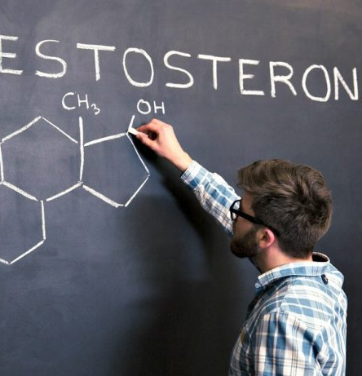
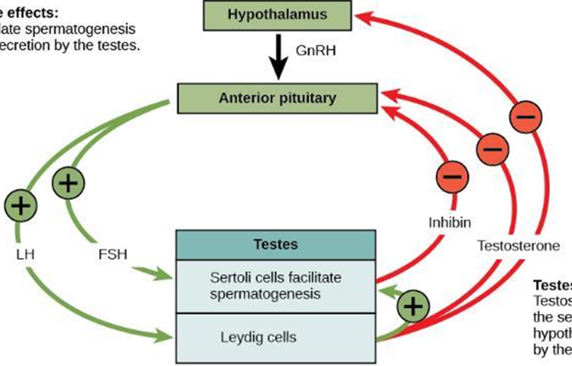
Male Hormones
Testosterone
stimulates spermatogenesis.
This hormone is also responsible for the secondary sexual characteristics that develop in the male during adolescence.
The secondary sex characteristics in males includes: a deepening of the voice, the growth of facial, axillary, and pubic hair, an increase in muscle bulk, and the beginnings of the sex drive.
This Photo by Unknown Author is licensed under CC BY-NC-ND

Slide 34
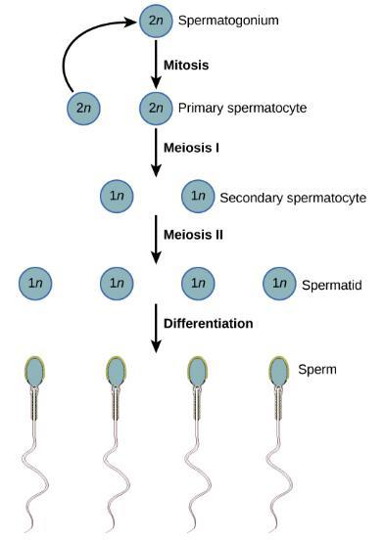
Spermatogenesis
Four sperm result from each primary spermatocyte.
The original spermatocyte is produced by Mitosis
It then goes through Meiosis I to produce 2 secondary spermatocytes
Meiosis II follows to produce 4 sperm

Slide 35
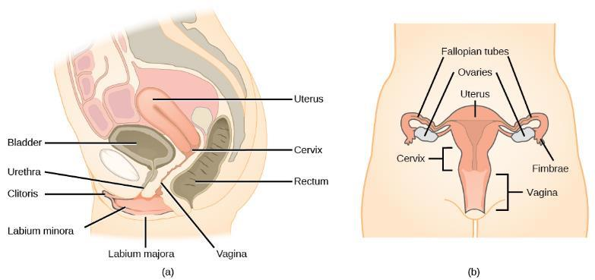
Female Reproductive Anatomy
Ovaries of female vertebrates
Produce ova
Secrete female sex hormones, estrogen, and progesterone
Placental mammals
Walls of uterus establish close vascular association with embryonic membranes through a placenta

Slide 36
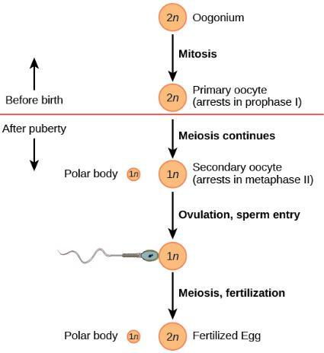
Oogenesis
All future eggs (oocytes) are in prophase I at the time of birth
Beginning at adolescence a few follicles are released in an ovary each month
Cell division is again arrested, this time at metaphase II.
At ovulation, the oocyte travels toward the uterus through the oviduct.
If the secondary oocyte is fertilized, the cell continues through meiosis II

Slide 37
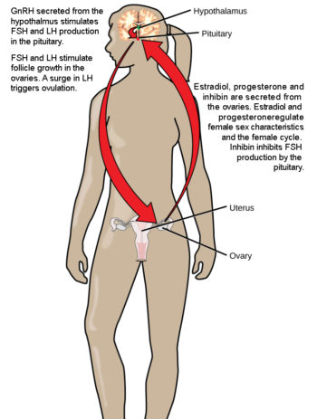
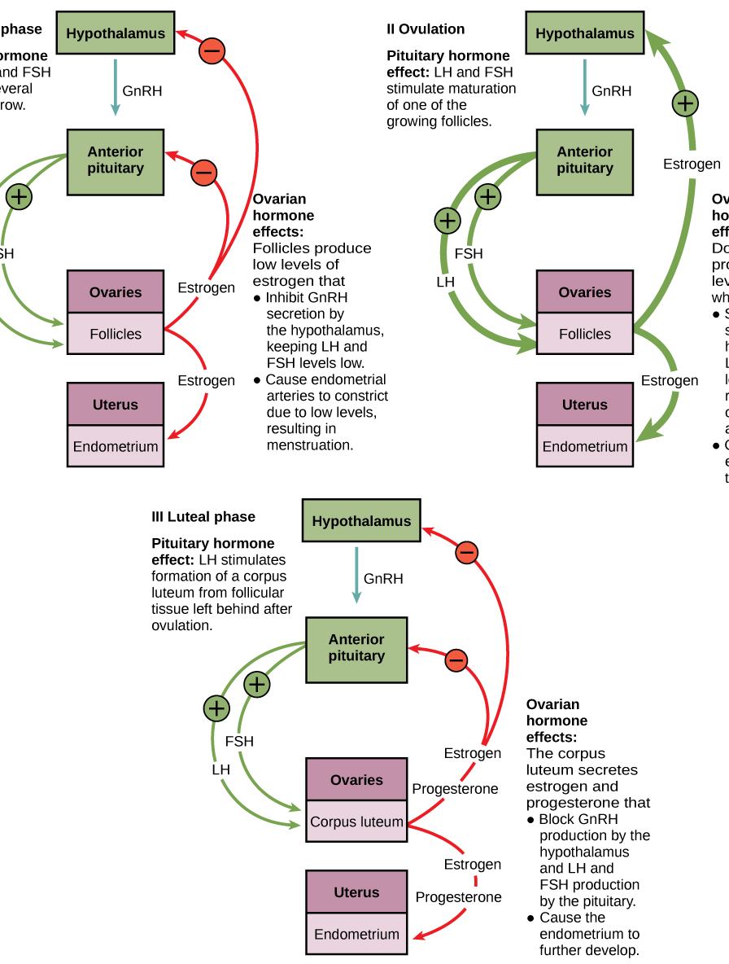
Female Hormones
The ovarian and menstrual cycles of female reproduction are regulated by hormones produced by the hypothalamus, pituitary, and ovaries.
estrogen and progesterone are released from the developing follicles.
Estrogen is responsible for the secondary sexual characteristics of females.
These include breast development, pubic hair, flaring of the hips, and a shorter period for bone growth.
This Photo by Unknown Author is licensed under CC BY

Slide 38
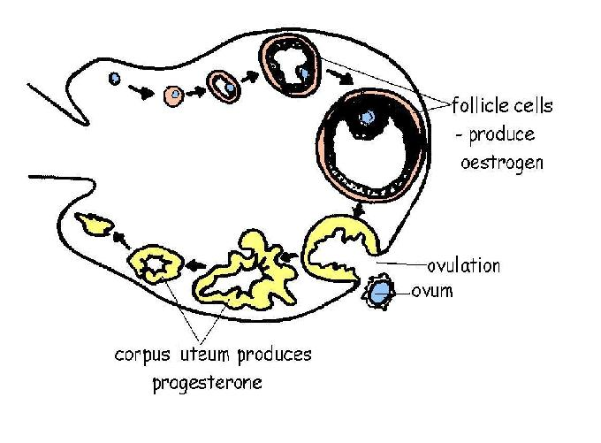
The Ovarian Cycle
Regulated by hormones of the hypothalamus, pituitary, and ovaries (Figure 18.17).
Follicular Phase (Day 1 – 13)
Ovulation (Day 14)
Luteal Phase (Day 15 – 28)
Corpus luteum (remnants of ovarian follicle)
Prepares uterus to undergo changes in preparation for gestation
If no fertilization, CL breaks down and causes uterus lining (endometrium) to break down
This Photo by Unknown Author is licensed under CC BY-SA-NC

Slide 39
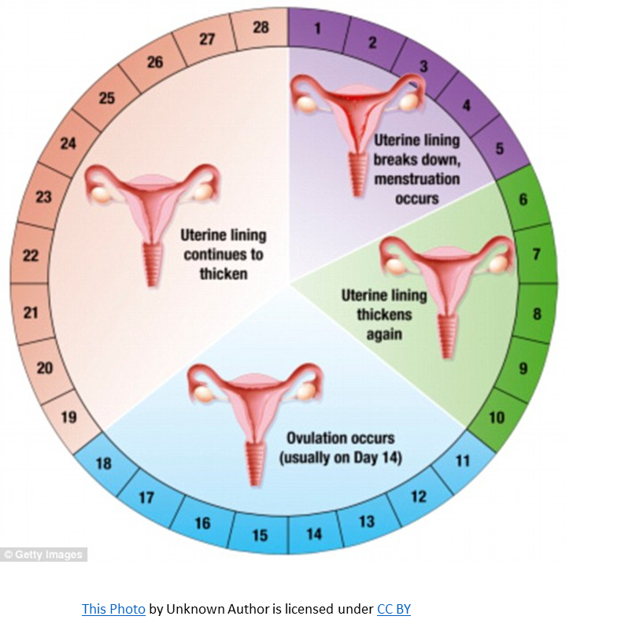
The Menstrual Cycle
Menstrual Phase (Day 1 – 5)
Due to low blood estrogen levels
Outer layer of endometrium degenerates and sloughs off
Proliferative Phase (Day 6 – 15)
As blood levels of estrogen rise
Endometrium heals and thickens
Secretory Phase (Day 16 – 28)
Uterus enters secretory phase if embryo implants
Progesterone secreted by the corpus luteum
Stimulates activity of uterine glands

Slide 40
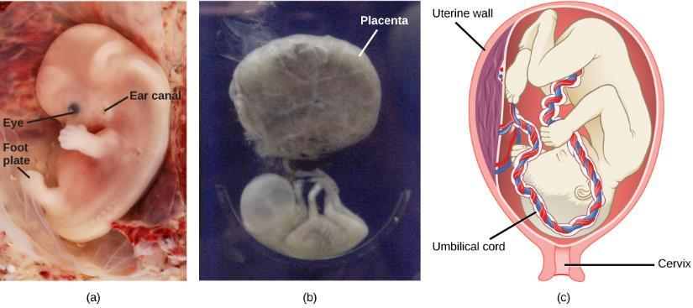
Gestation
In humans is 266 days and is similar in other great apes
a. Fetal development is shown at nine weeks gestation.
b. This fetus is just entering the second trimester, when the placenta takes over more of the functions performed as the baby develops.
There is rapid fetal growth during the third trimester. (credit a: modification of work by Ed Uthman; credit b: modification of work by National Museum of Health and Medicine; credit c: modification of work by Gray’s Anatomy)

Slide 41
Question 1
Which is a disadvantage of sexual reproduction?
each offspring is a genetically unique animal (new combinations of traits, genes)
this variability can increase chances for survival in the environment
variation is the foundation for evolution
animals can’t reproduce on their own

Slide 42
Question 2
These animals nourish their young in a pouch after a short gestation in the female.
Ectotherms
Endotherms
Placentals
Marsupials

Slide 43
Question 3
This is the spontaneous activation of a mature egg, followed by normal cell divisions and subsequent embryonic development.
Spontaneous generation
Internal fertilization
Parthenogenesis
Fragmentation

Slide 44
Next
Exam 3 Wednesday November 15th
Thermoregulation Ch 16.1
Digestive System Ch 16.2
Circulation Ch 16.3
Endocrine System Ch 16.4
Skeletal/Muscular Ch 16.5
Nervous System Ch 16.6
Reproduction Ch 18
MMM final research due, slides due
Finish PowerPoint of your animal by week of November 27th
Put slides into Group presentation
Submit slides to Blackboard by week of November 27th

